Slide 1
Meeting 2025-04-29
Immunity linking for NC Influenza model

Slide 2
Gen 1 → Gen 2
Gen 1 results encouraging
“Discrepancy modeling” by D. Osthus (2019)→ similar methodology with sufficiently different focus (no focus on immunity (linking), strains, different datastreams, etc. more statistic less “practical”)
Gen 1 model still had “unnecessary” complexities
age groups + sequential infection
Keep it SIMPLE → Goal is forecasting, epi < accuracy!
Gen 1 was slow
330.000 core hours used to perform experiments
Fwd simulation rewritten in C++ → 10-15 x speedup overall

Slide 3
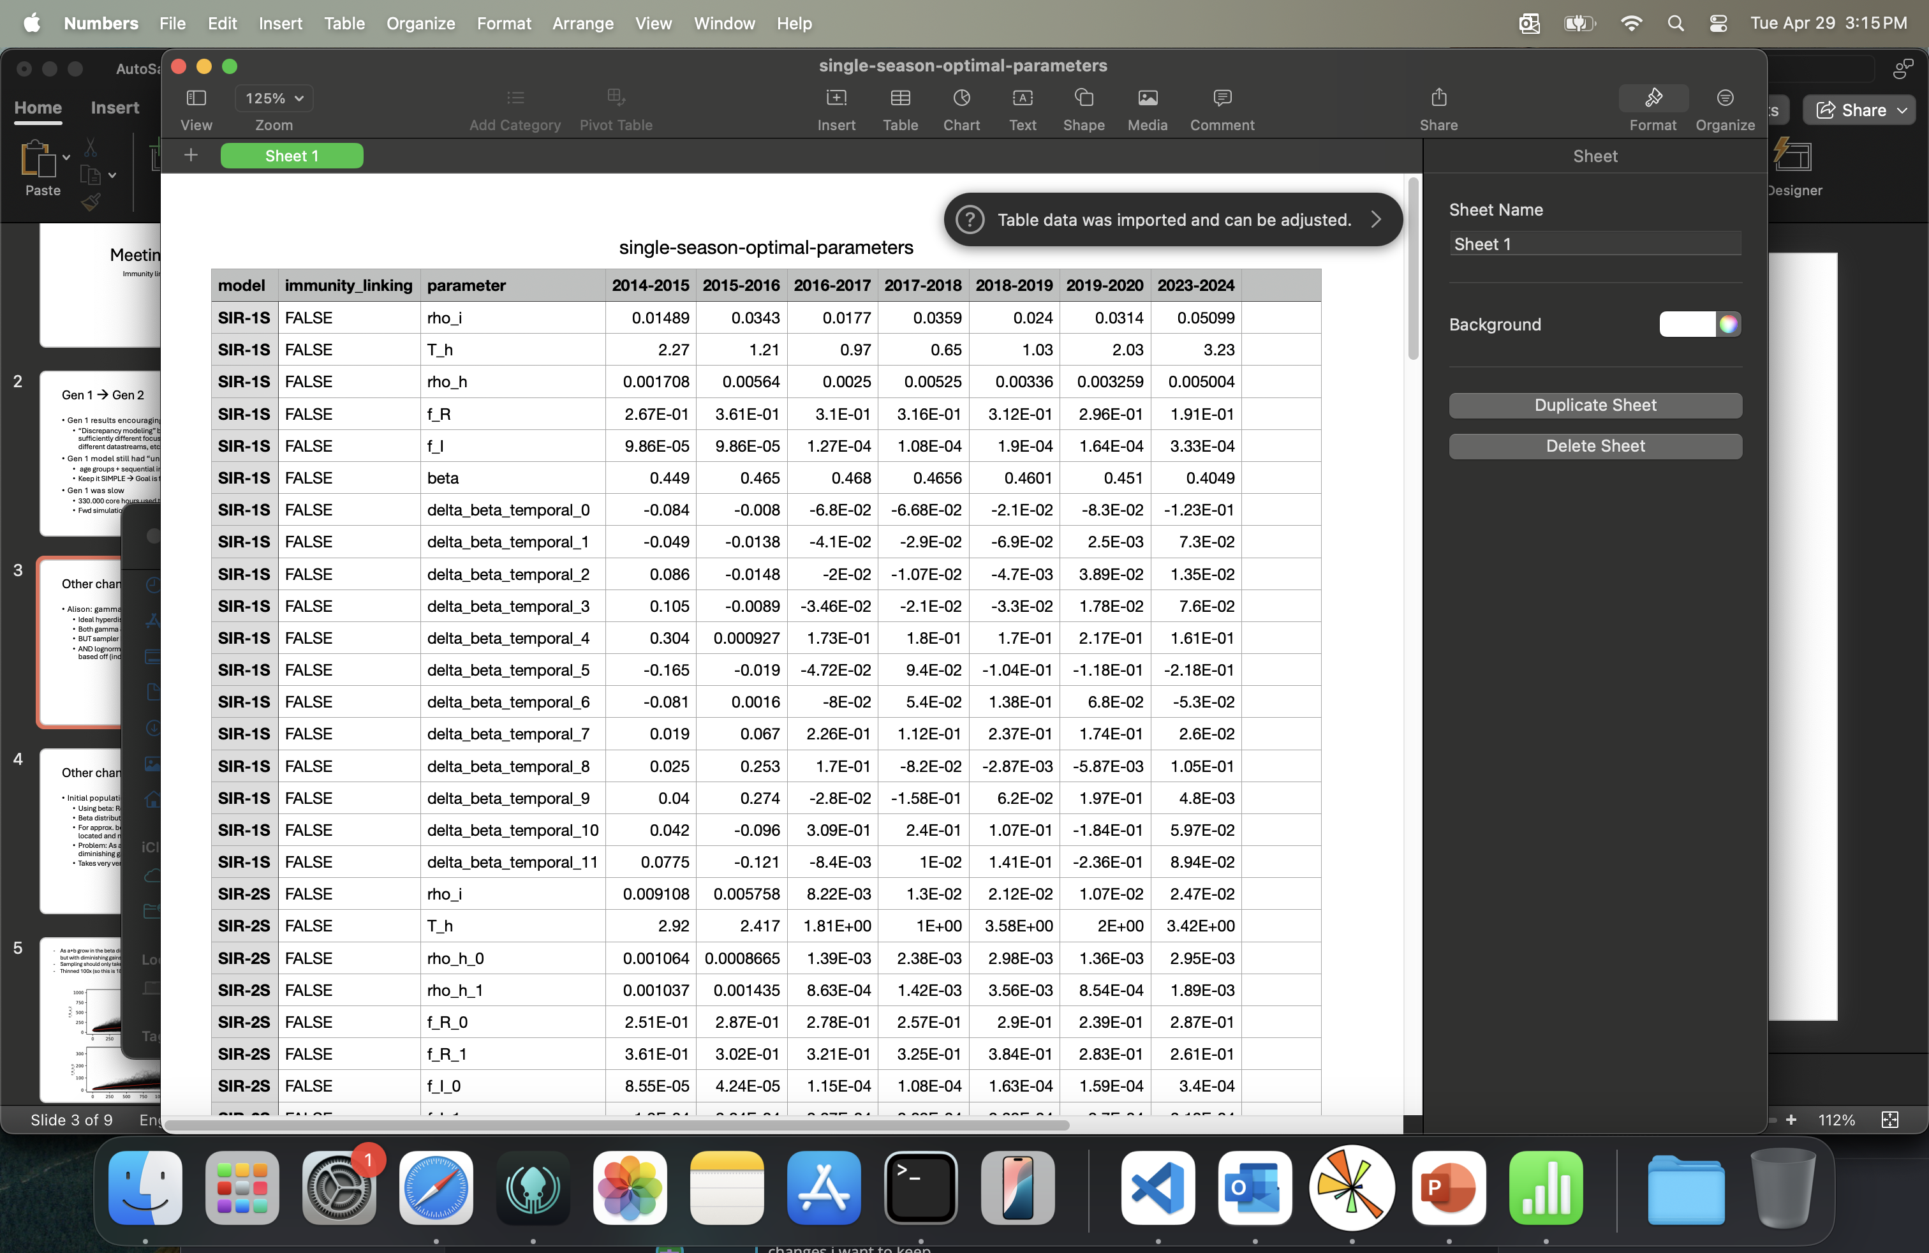
Other changes made
Alison: gamma distributions → lognormal distributions
Ideal hyperdistributions have a bell shape (heavy tail = more uncertain)
Both gamma & lognormal can have a bell shape
BUT sampler has more trouble parametrizing gamma with bell shape
AND lognormal initial guesses for mu,sigma are intuitive to formulate based off (independent) single-season fits
Average & stdev can inform initial guess of parameters hyperdistributions

Slide 4
Other changes made
Initial population immunity f_R: beta dist –> normal dist
Using beta: Result was f_R ~ N(0.3, 0.05) – ish and bell shaped
Beta distribution has two parameters: a & b
For approx. bell-shaped beta dist: ratio of a / b determines where mean is located and magnitude a + b determines sigma.
Problem: As a+b goes up, sigma asymptomatically tends to zero with diminishing gains → as a+b goes up sampling becomes insensitive
Takes very very long for ensemble

Slide 5
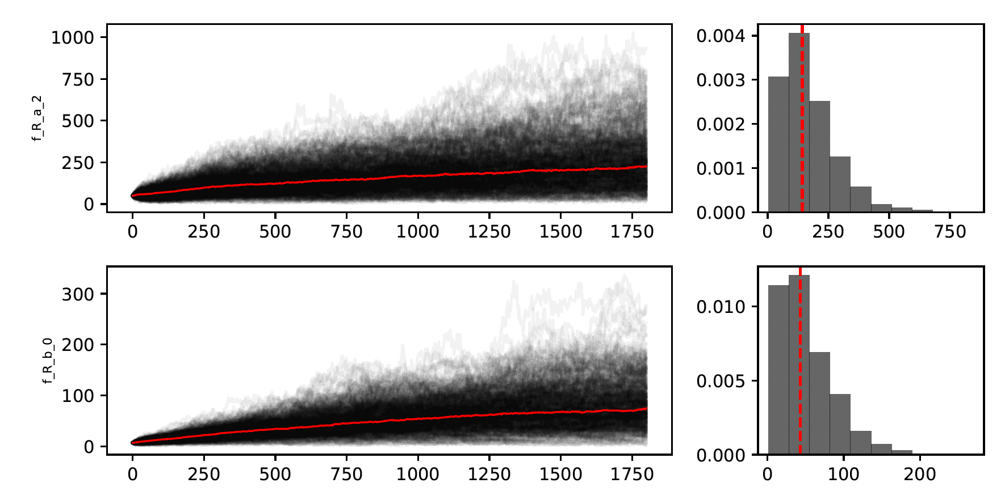
As a+b grow in the beta distribution, the sigma of the approximate normal distribution becomes smaller, but with diminishing gains → sampler loses sensitivity as a+b grows
Sampling should only take about 30 000 iterations to “flatten”
Thinned 100x (so this is 180 000 MCMC)

Slide 6
Immunity linking
Found H1/H3 subtype data
1-strain, 2-strain and 3-strain SIR
Immunity linking
Direct estimation f_R → functional relationship to past incidence

Slide 7
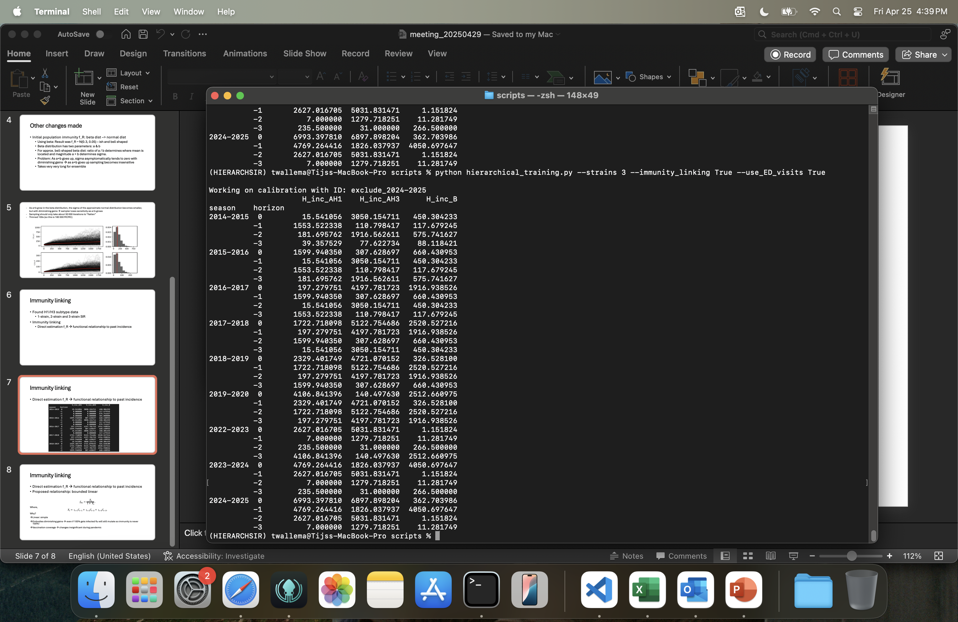
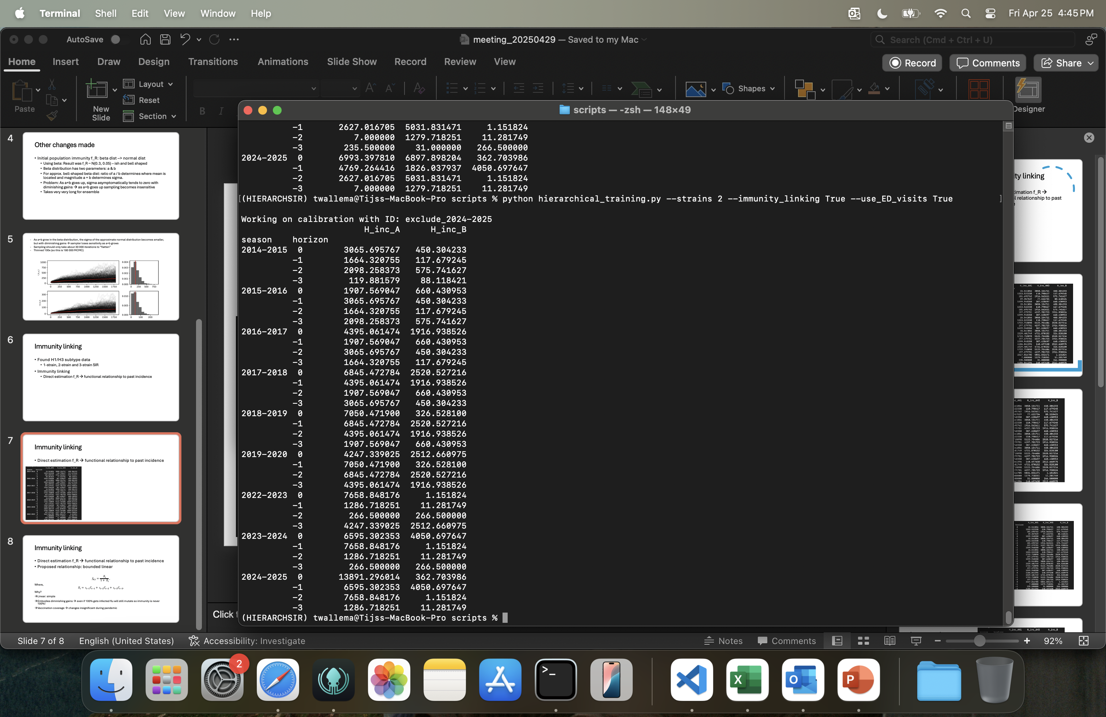
Immunity linking
Direct estimation f_R → functional relationship to past incidence

Slide 8
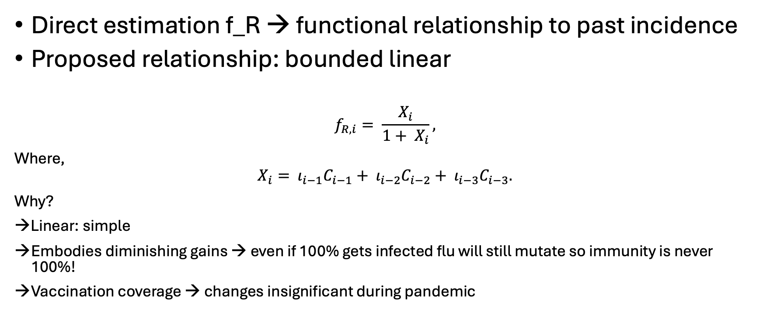
Immunity linking
Direct estimation f_R → functional relationship to past incidence
Proposed relationship: bounded linear
$$f_{R,i}= \frac{X_{i}}{1+ X_{i}},$$
Where,
$$X_{i}= ι_{i−1}C_{i−1}+ ι_{i−2}C_{i−2}+ ι_{i−3}C_{i−3}.$$
Why?
→Linear: simple
Embodies diminishing gains → even if 100% gets infected flu will still mutate so immunity is never 100%!
Vaccination coverage → changes insignificant during pandemic

Slide 9
Overview experiment “leave-one-out”
1/2/3 strains
ED visits (ILI datastream): YES/NO
Immunity linking: YES/NO
Required allocation:
Training: 3 x 2 x 2 = 12 “models” with 7 training seasons x 12 h per training on 48 CPU cores = 55.000 CPU hours
Forecasting: 0.25*48 CPU hours per forecast x 25 forecasts per season x 7 seasons x 12 models = 25.000 CPU hours

Slide 10
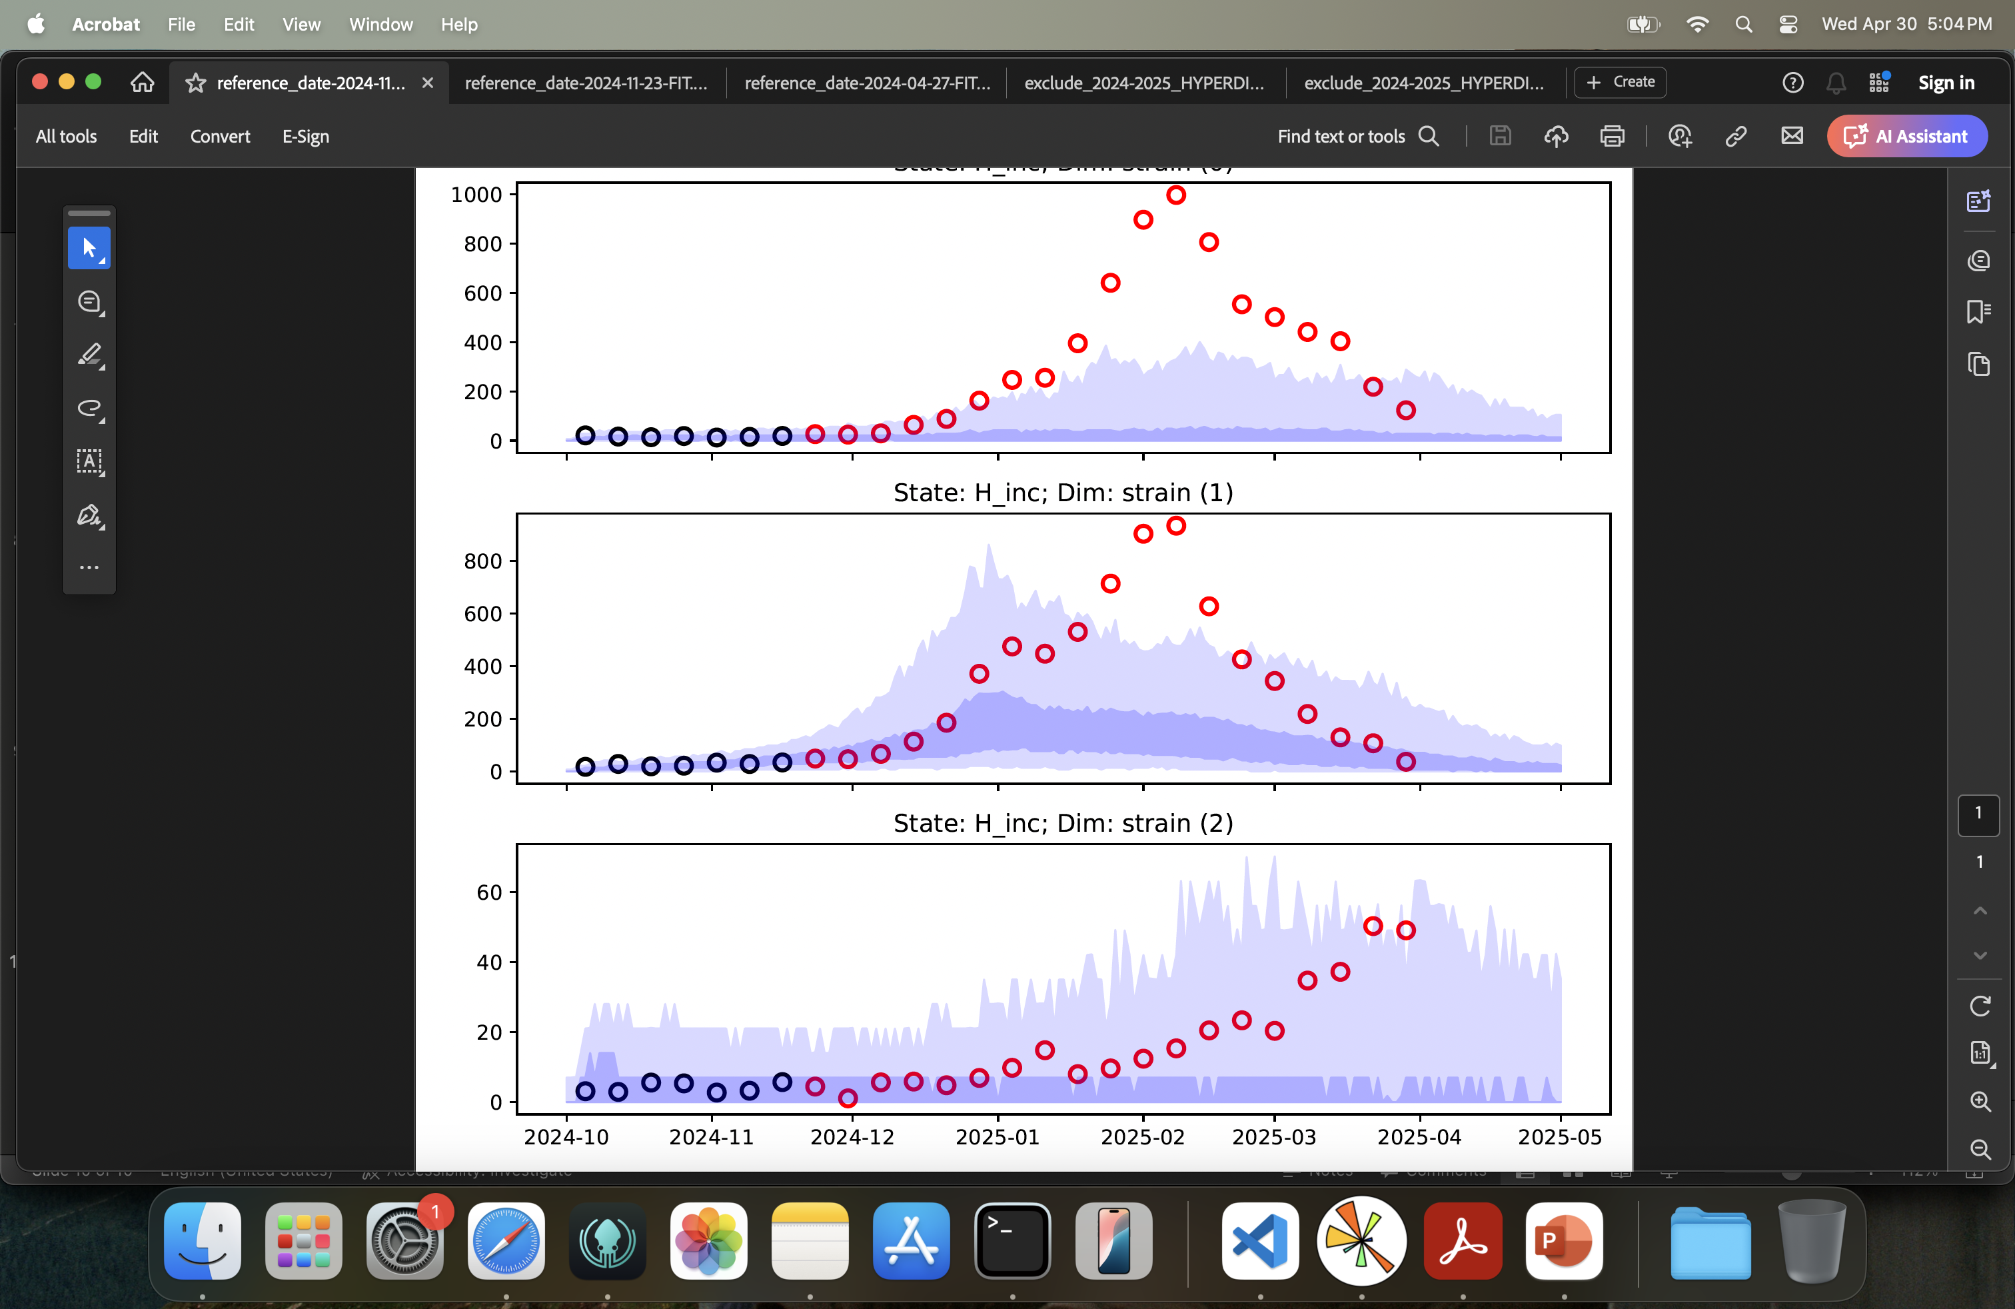
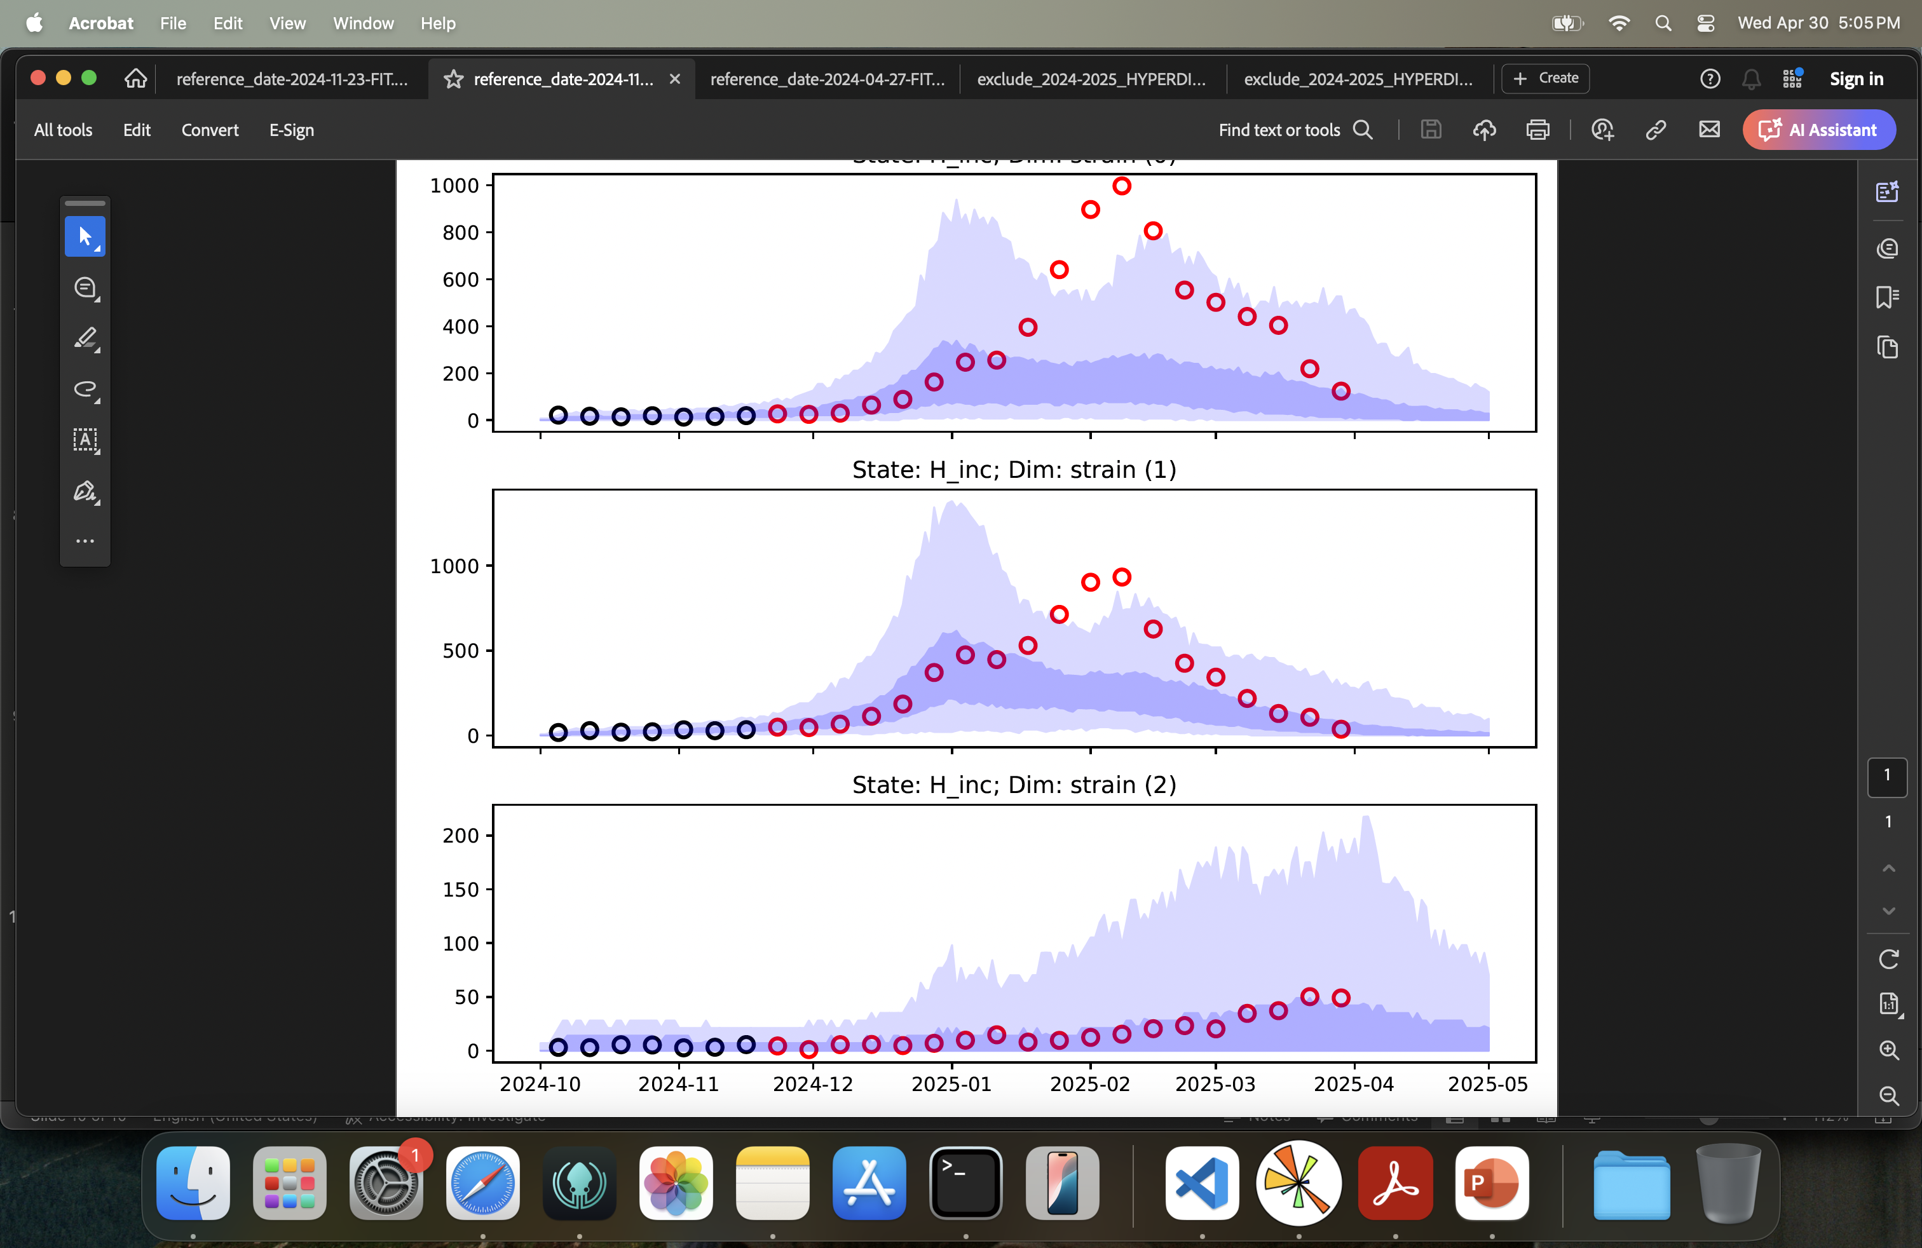
Impact immunity linking visualised
Season 2024-2025
With immunity linking
w/o immunity linking
A(H1)
A(H3)
B

Slide 11
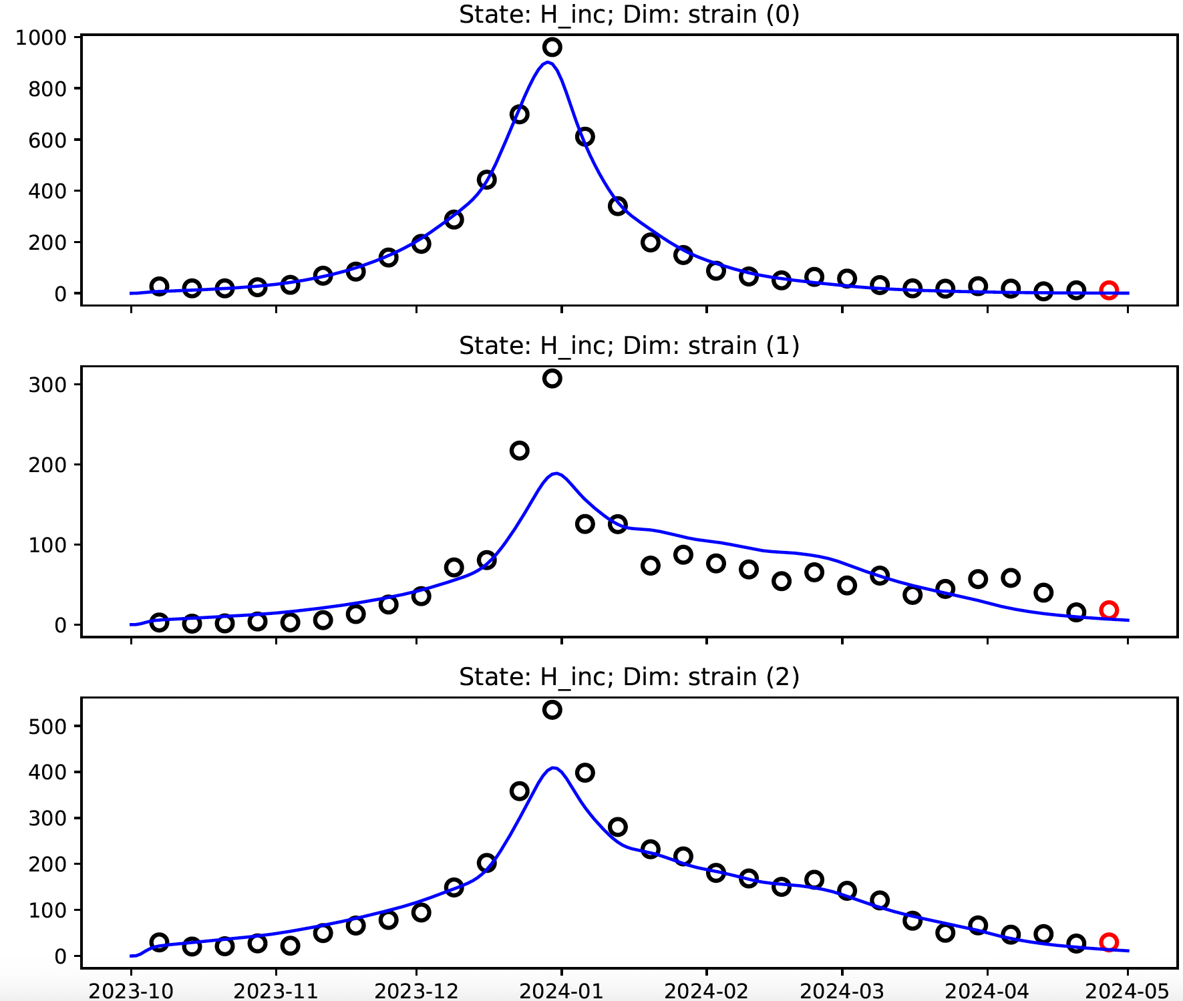
Impact immunity linking visualised
Season 2023-2024
Season 2022-2023

Slide 12
Impact immunity linking visualised
Season 2024-2025
With immunity linking
Immunity linking’s effect is plausible given its functional form → more cases on past 3 year horizon = less cases this year

Slide 13
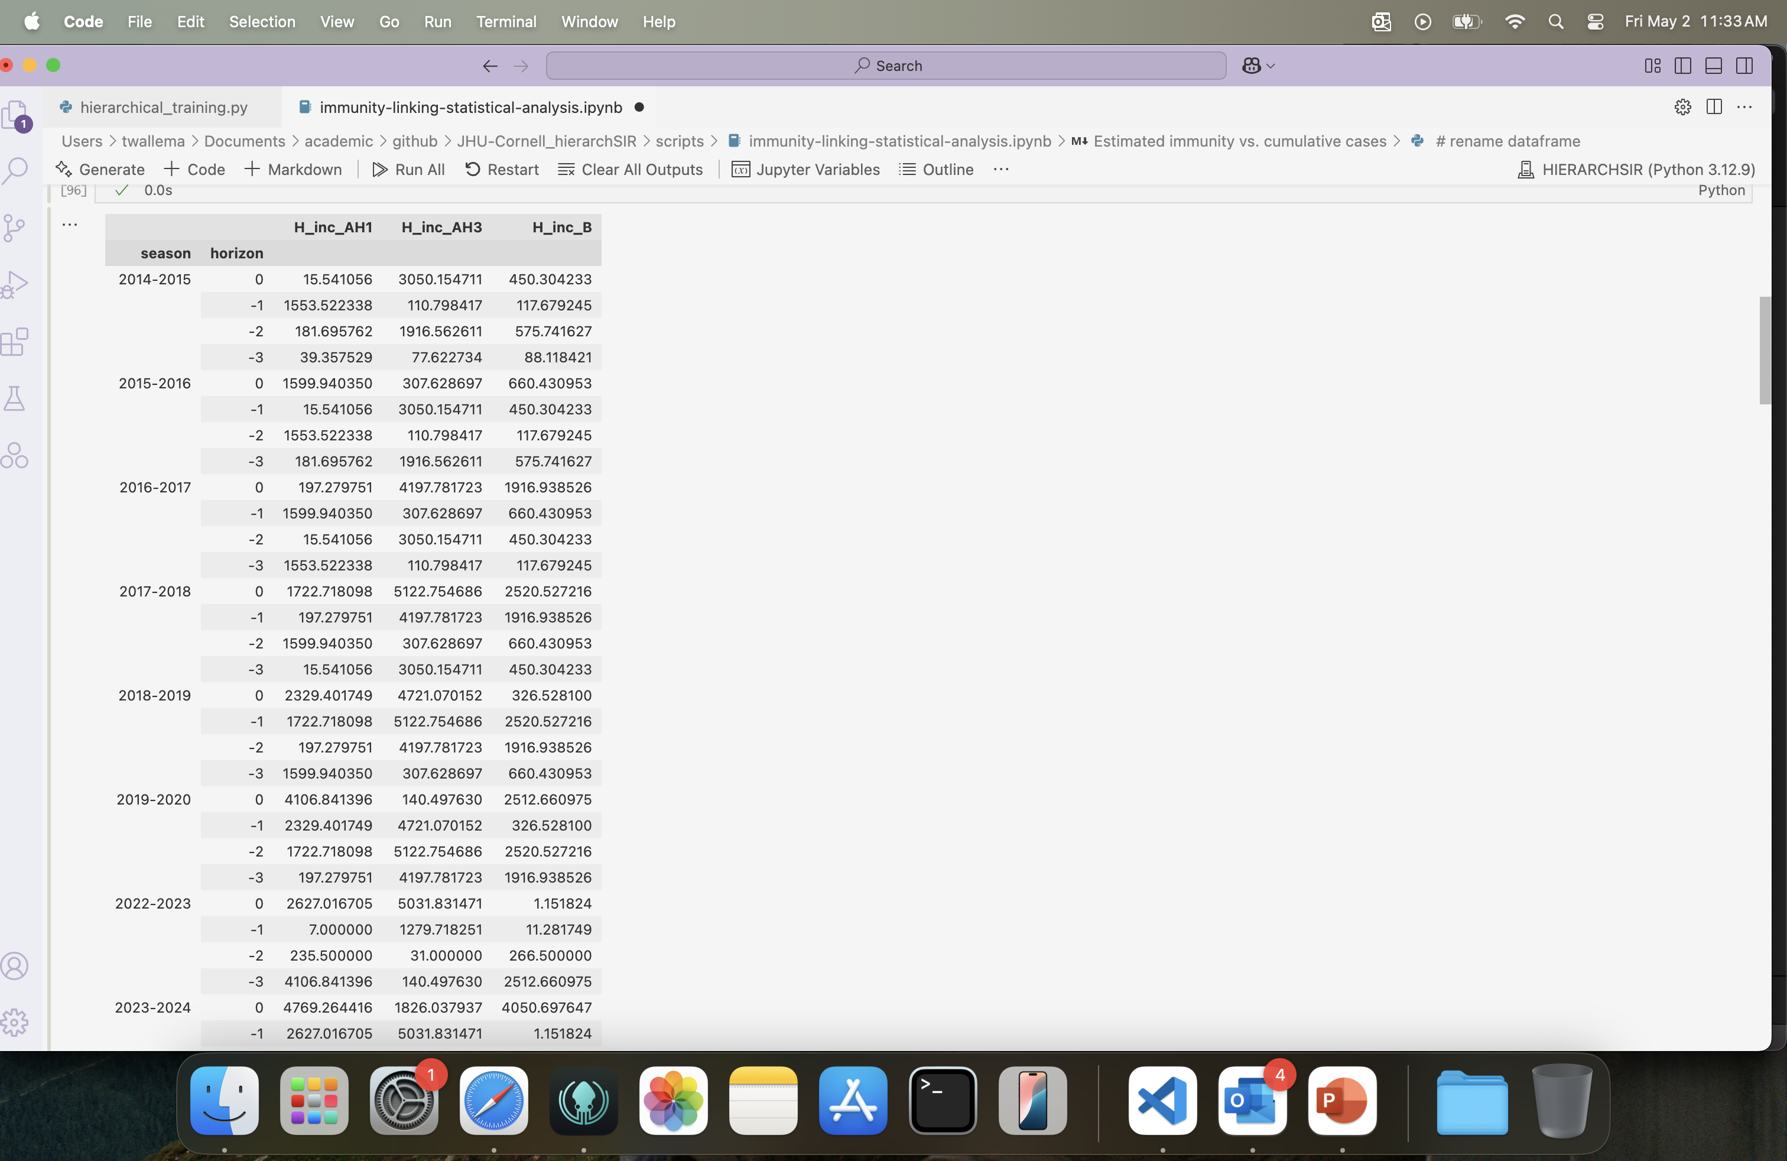
Statistical analysis: data
Influenza A(H1) & A(H3)
Alternate from 2014-2015 to 2016-2017
2017-2018 trend ‘breaks’→ second large H3 season in a row → 2018-2019: trend breaks for H1 too + 3rd large H3 season in a row
2017-2018 until 2019-2020 : cases trend upward for H1
Influenza B
Still 2 strains so complex pattern is expected

Slide 14
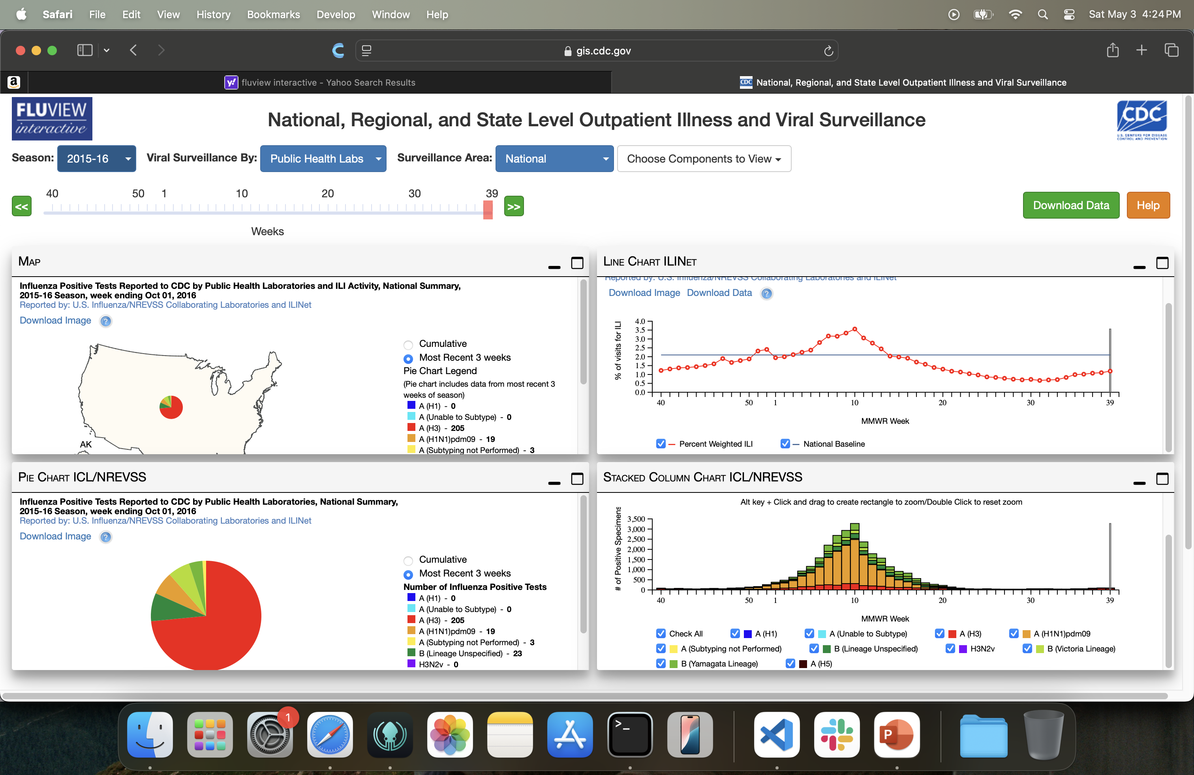
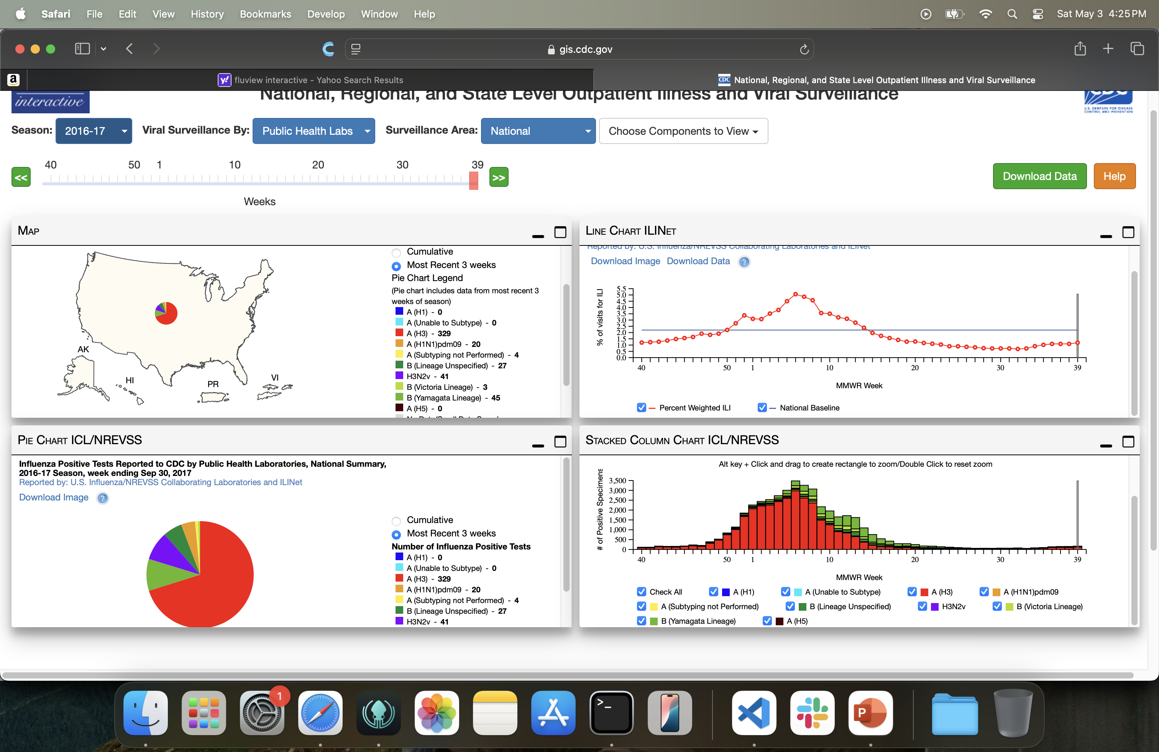
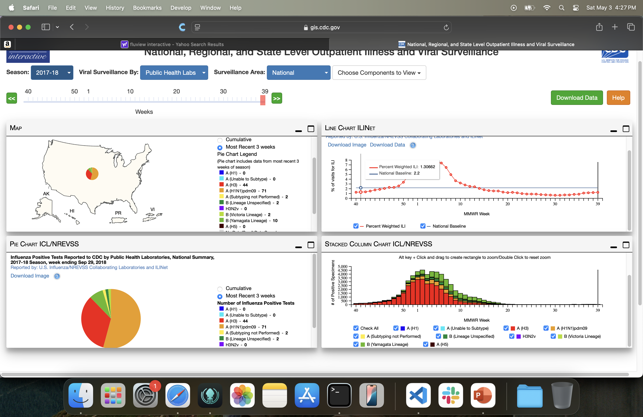
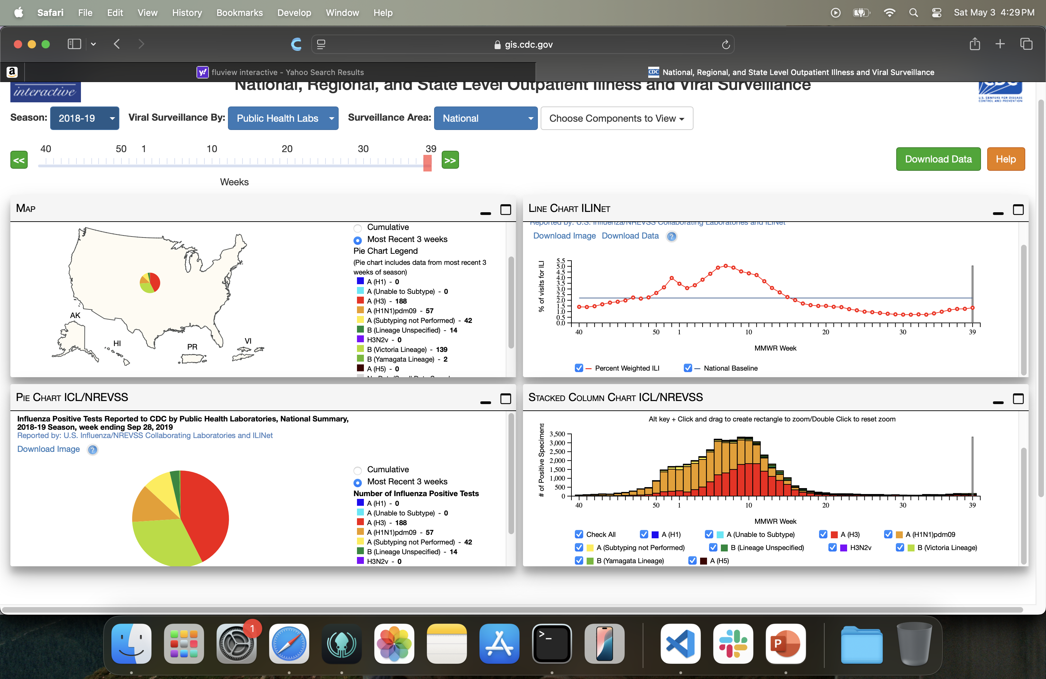
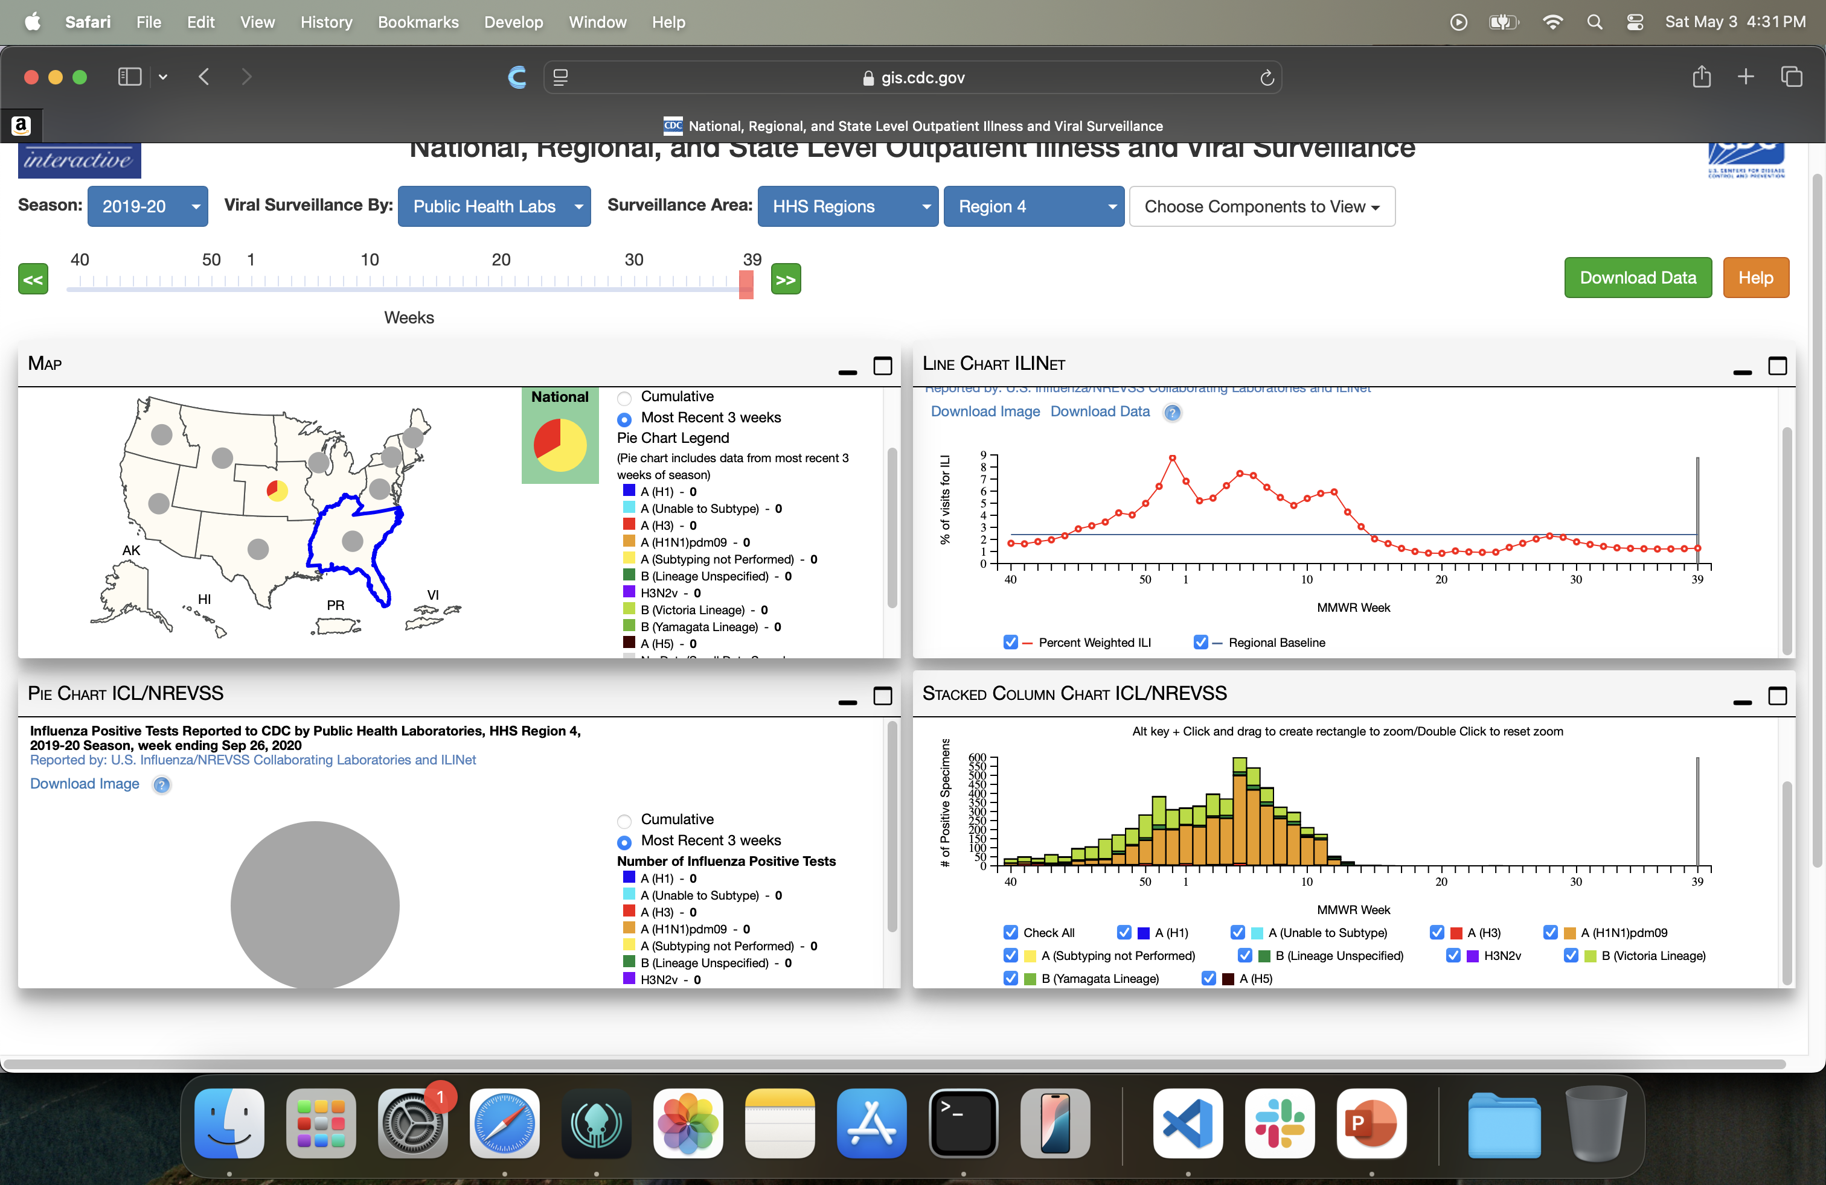

Statistical analysis: data
2015-2016
Influenza A(H1) & A(H3)
Alternate from 2014-2015 to 2016-2017
2017-2018 trend ‘breaks’→ second large H3 season in a row → 2018-2019: trend breaks for H1 too + 3rd large H3 season in a row
2017-2018 until 2019-2020 : cases trend upward for H1
Influenza B
Still 2 strains so complex pattern is expected
2016-2017
2017-2018
2018-2019
2019-2020

Slide 15
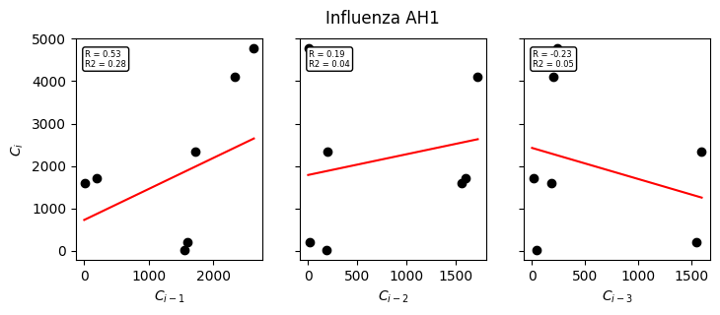
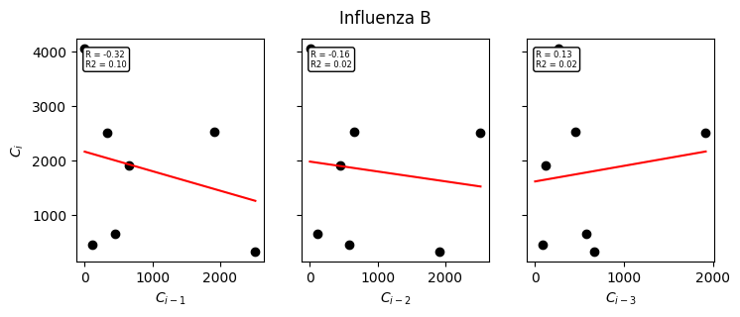
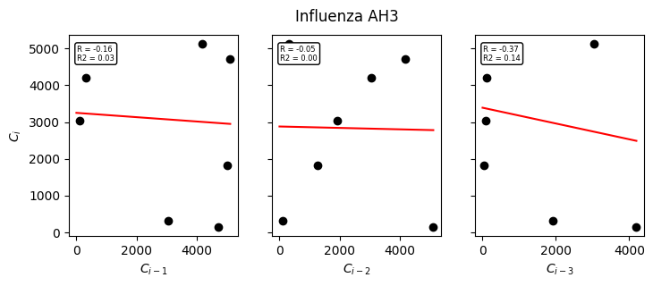
Statistical analysis: # cases
Expectation: negative correlation
--> AH1: weak positive correlation C_{i} ~ C_{i-1} (R2=0.28) likely due to drift
→ AH3 & B: nothing notable going on

Slide 16
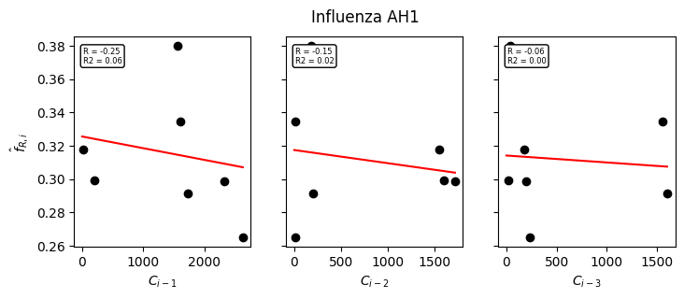
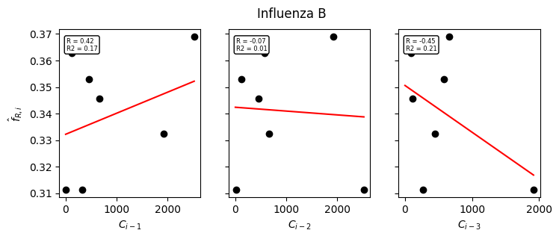
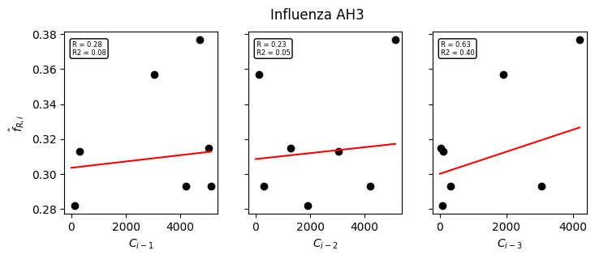

Statistical analysis: modeled immunity
Expectation: positive correlation
AH3: weak positive correlation C_{i} ~ C_{i-3} (R2=0.40)
B: weak negative correlation C_{i} ~ C_{i-3} (R2 = 0.21)
→ H1: nothing notable going on

Slide 17
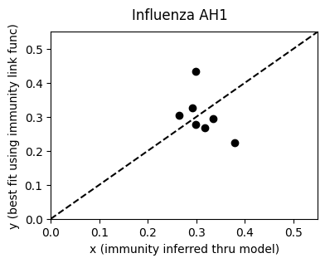
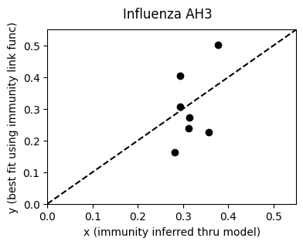
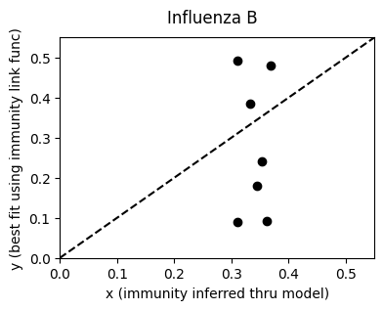
Statistical analysis: testing the link function
Procedure:
Modeled immunity from hierarchically trained model as x-variable
See if immunity link function can predict inferred immunity from model without immunity linking
Optimize parameters immunity link function

Slide 18

Impact of the link function
Using link function → “force” the model to obey the heuristic “more cases in the past is less cases this season”
small
large
Seasonal trend strong → individual trajectories close to hyperdistribution = small residual within-season noise = DESIREABLE!

Slide 19

Impact of the link function
Using link function → “force” the model to obey the heuristic “more cases in the past is less cases this season”
large
Seasonal trend attenuated → individual trajectories further from hyperdistribution = larger residual within-season noise = UNDESIREABLE!

Slide 20
Impact of the link function
W/o link function: prior immunity f_R hyperdistribution is quite ”loose” with a clearly defined R0 ~ 1.6 and modifiers which reveal a seasonal pattern with low within-season residual noise
With link function: Uncertainty shifted into the R0 and the modifiers have less defined seasonal pattern and higher within-season residual noise
All evidence combined: link functions are unlikely to result in greater accuracy of the model
The question is: Do we include link functions systematically in a paper, even if it doesn’t work, just to demonstrate to the community – which intuitively feels this should work -- that it doesn’t?

Slide 21
How about the Belgian dataset

Slide 22
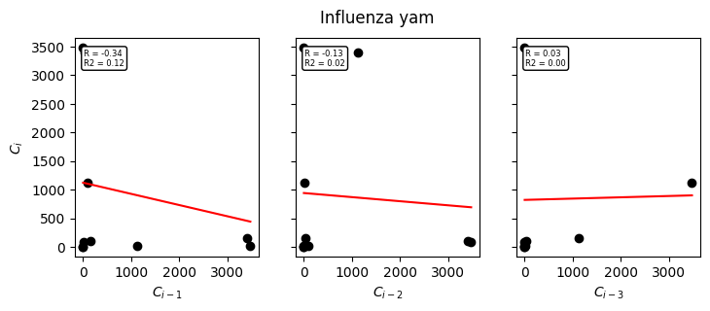
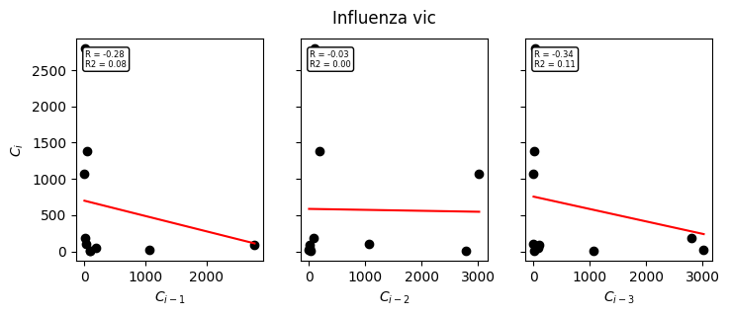
How about the Belgian dataset
Influenza B
Doesn’t have much going on
Very intermittent peaks so makes sense
Could still look at sum of yam+vic or longer time horizon

Slide 23
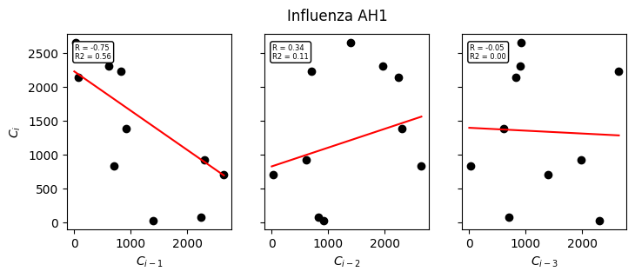
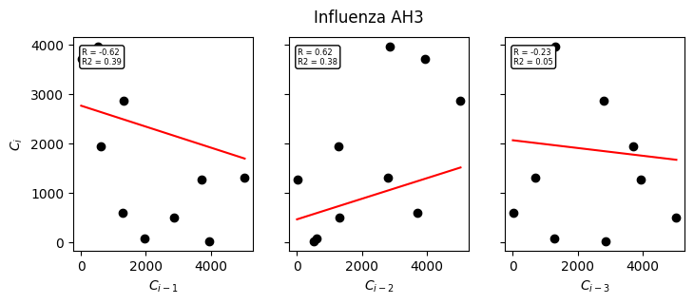
How about the Belgian dataset
Influenza A
Sensible and “strong” correlations
Negative correlation with season -1
Positive correlation with season -2
Little impact by season -3, although both negative
For Belgium: immunity linking is very likely going to work!

